Slide 1

Wolfpak
Godfrey Ndu
5/30/2022

Slide 2

Agenda
Pre Wolfpak: Wolfpak Predecessor, Data processing, Data storage, Data accessibility
Intro to Wolfpak
Technical details
Wolfpak as a backend data backbone
Wolfpak Demo
Future Of Data

Slide 3

Pre-Wolfpak
Voodoo: A slow and inefficient data gathering script designed by IDirect.
Data stored locally in csv files and burdensome to access and utilize
Absence of Realtime analytics
Little to no data Visualization
Use of outdated programming tools
Over Exertion of PP_TPA due to numerous telnet sessions
No data backbone

Slide 4
Understanding Wolfpak
Why the name Wolfpak?
What is Wolfpak?
Why was Wolfpak Designed?
Wolfpak is a program built with the intent of creating a robust monitoring system for data present in the backend of the flex network systems
The Wolfpak program mimics the behavior of a Pack of Wolves during hunting
Tailored Specifically to meet the data needs of the Intelsat Neteng Team
90% more efficient than its predecessor

Slide 5
Pillars Of Wolfpak
Intro
Data Decentralization
Parallel Programming
Speed
Durability
Convenience

Slide 6
Technicalities Of Wolfpak
Innovation, design ingenuity and creativity
Ran on a Cronjob every 10mins (can be ran every 5mins)
Cluster(s) required to be swept is initialized
Identifies all servers and other information associated with the cluster(s)
Simultaneously SSH into servers by means of Multiprocessing and Paramiko
Acquires PP_TPA address specific to each server
One time telnet to get a list of online remotes
Logs into each remote, runs several commands and outputs processed information
Utilized Hash data structure for data modelling
Transports data into Influx database
Ability for all clusters to be swept from one central location
Ability to simultaneously SSH and process multiple servers
Ability to retry login sequence up to 2 times
Times-series database Integration
Framework versatility
Reflexive Ability
Detailed Log files
Debugging ease
User and Programmer Friendly
Speed (4.5mins for biggest cluster FUSIS37

Slide 7
Voodoo Vs Wolfpak
Wolfpak
Voodoo
One SSH and Telnet Session per server
Utilizes latest version of Python3
Utilizes Paramiko library for server interaction
Multiprocessing for servers
Data model: Hash data Structure
99% efficiency in remote processing
Designed in a manner that allows for quick and easy debugging for errors
Understandable log file: error accounting
Integration with Influxdb
Integration of Realtime dashboards
High processing speed (90% faster than voodoo, over 1.6k remotes in less that 4mins)
On demand data availability for maintenance
Adapted to PP_TPA inconsistencies
Easy to run
Designed with as much file/script independence as possible
Easy to carry out upgrades
Multiple telnet sessions per server: one telnet per remote
Some files written in Python 2 and outdated
Pexpect Library for server interaction
No parallel programing (linear/sequential server processing)
Linear data structure
65% efficiency in remote processing
Incomprehensible logfile
No database integration; utilized csv files for data storage
No Realtime dashboard; utilized Pandas & matplotlib to create data snapshots
Very slow processing speed(800 remotes in 35-40mins)
No on demand data
Not adapted to PP_TPA inconsistencies
Complicated to run
Very bogus script with multiple files and dependencies
hard to upgrade

Slide 8
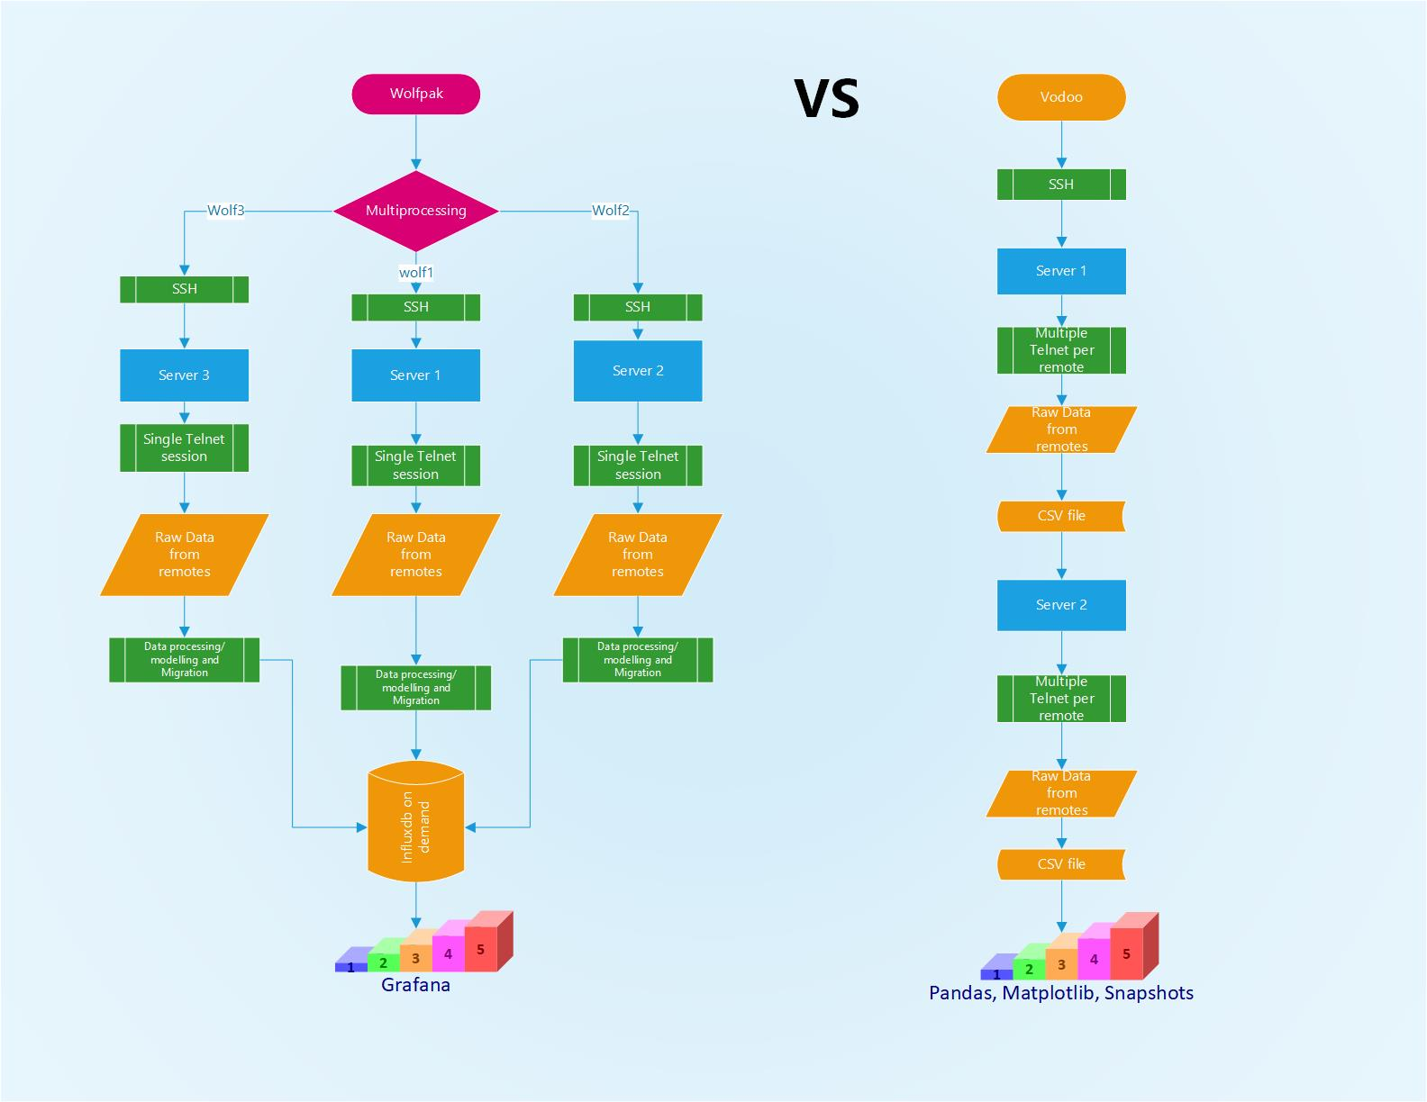

Slide 9
Wolfpak Powered Dashboards
Dashboards overview
Wolfpak Mainet (level 0): Consists of several high-level data panels. Some of these panels give data insights related to total number of online terminals, CRC Errors delta of Inets, dynamic range of inets, hub and individual terminal weather info, beam and satellite hysteresis, fade, rhucp values and so on
Wolfpak Inets data (level 1): Consists of panels that drill down to the Inet level to produce data visuals specific to individual inets on information such as Average upstream CNO, Average downstream SNR, Distinct Nominal carries and so on
Wolfpak Inets data (level 2): This dashboard consists of a single panel that displays the distribution of terminals across carries in an individual Inet.

Slide 10
Realtime Demo

Slide 11
Project Merge
Pulse API
Backend
(PP_TPA)
Wolfpak
Influx DB

Slide 12
Wolfpak as a data Backbone
Programs currently designed on the Wolfpak Chassis
Aurora- A program powered by Wolfpak (and binary search Algorithm) that utilizes terminal information (name, lats & longs) from influx. Queries and external API to provide weather information on terminals and Hubs
NetAn- a program built on the backbone of the Wolfpak program. The NetAn program provides its users with the ability to carry out advanced data analytics across multiple timeframes on specific network data points pumped into the Influx database by Wolfpak
Inet_terminal_tracker: A program in the pipelines with a potential of tracking terminals movements across inets.

Slide 13

Pulse API
Backend
(PP_TPA)

